Slide 1
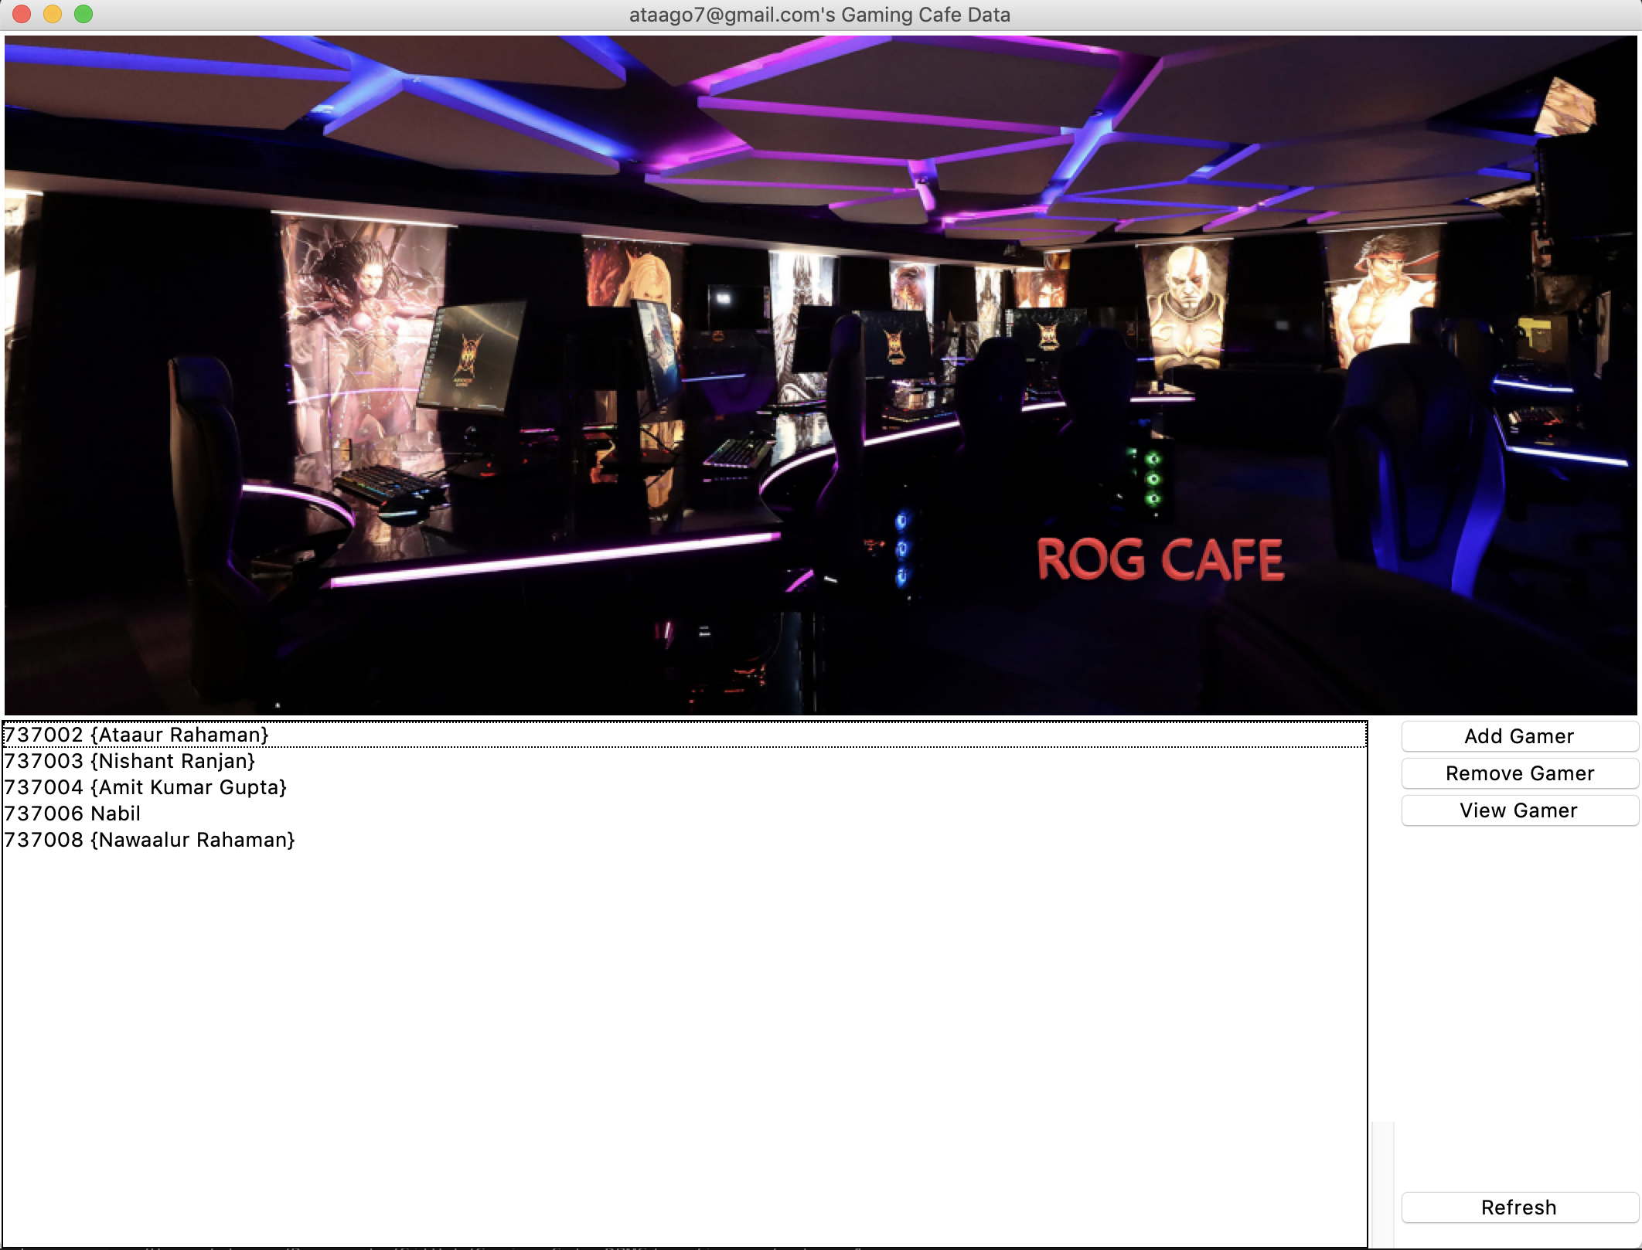
Gaming Café
Database Management Systems

Slide 2
The Problem
There are lot of gaming Cafes, but not many have an efficient way to manage its Gamers using a single Software.

Slide 3
The Solution
A software application which helps in storing all the information of the gamers playing in the café.
The café manager can store all its gamers profile in the Database management system built into the Gaming café application.

Slide 4
The Application
The owner has a secure way of logging into the main application with a separate database.
The application for the gaming café helps the manager to store its gamers data like, name, email, time spent, password etc.
The application is connected to other client computers the gamer can login to his/her PC using the ‘gamer_tag’ and ‘password’ which is managed from the application.
The manager can keep track of the gamers time spent on the machine to charge accordingly.(future Implementations)
The manager can also keep track of the games being played by individual gamers

Slide 5
The Database
The database has tables for Gamer, Games and Inventory.
The relations for the tables are:
Gamer play Games
Gamer has this Inventory

Slide 6
The Attributes
Gamer
Name
ID
Gamer Tag
Email
Age
Games
ID
Name
Genre
Release date
rating
Inventory
ID
Game ID
Game name
Playtime
level

Slide 7
ER Diagram

Slide 8
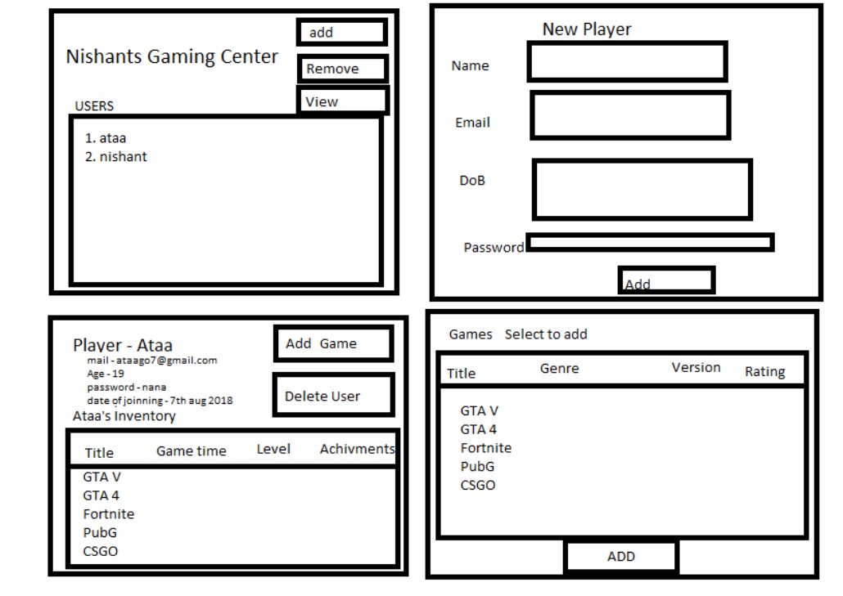
Layout Plan

Slide 9
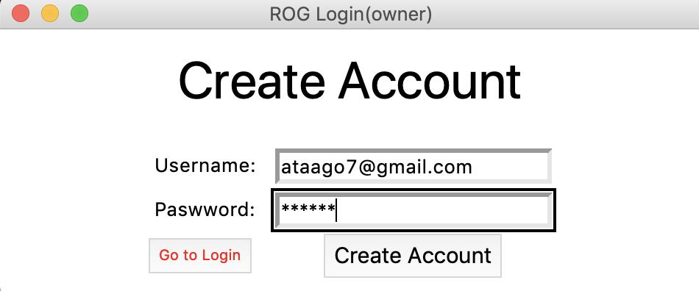
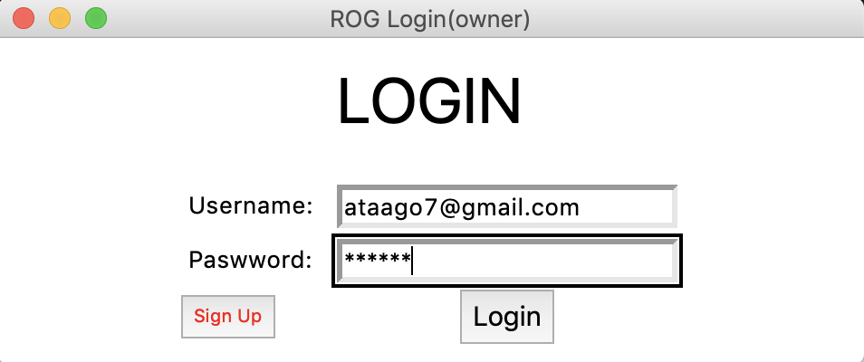

The application

Slide 10
Main Window

Slide 11
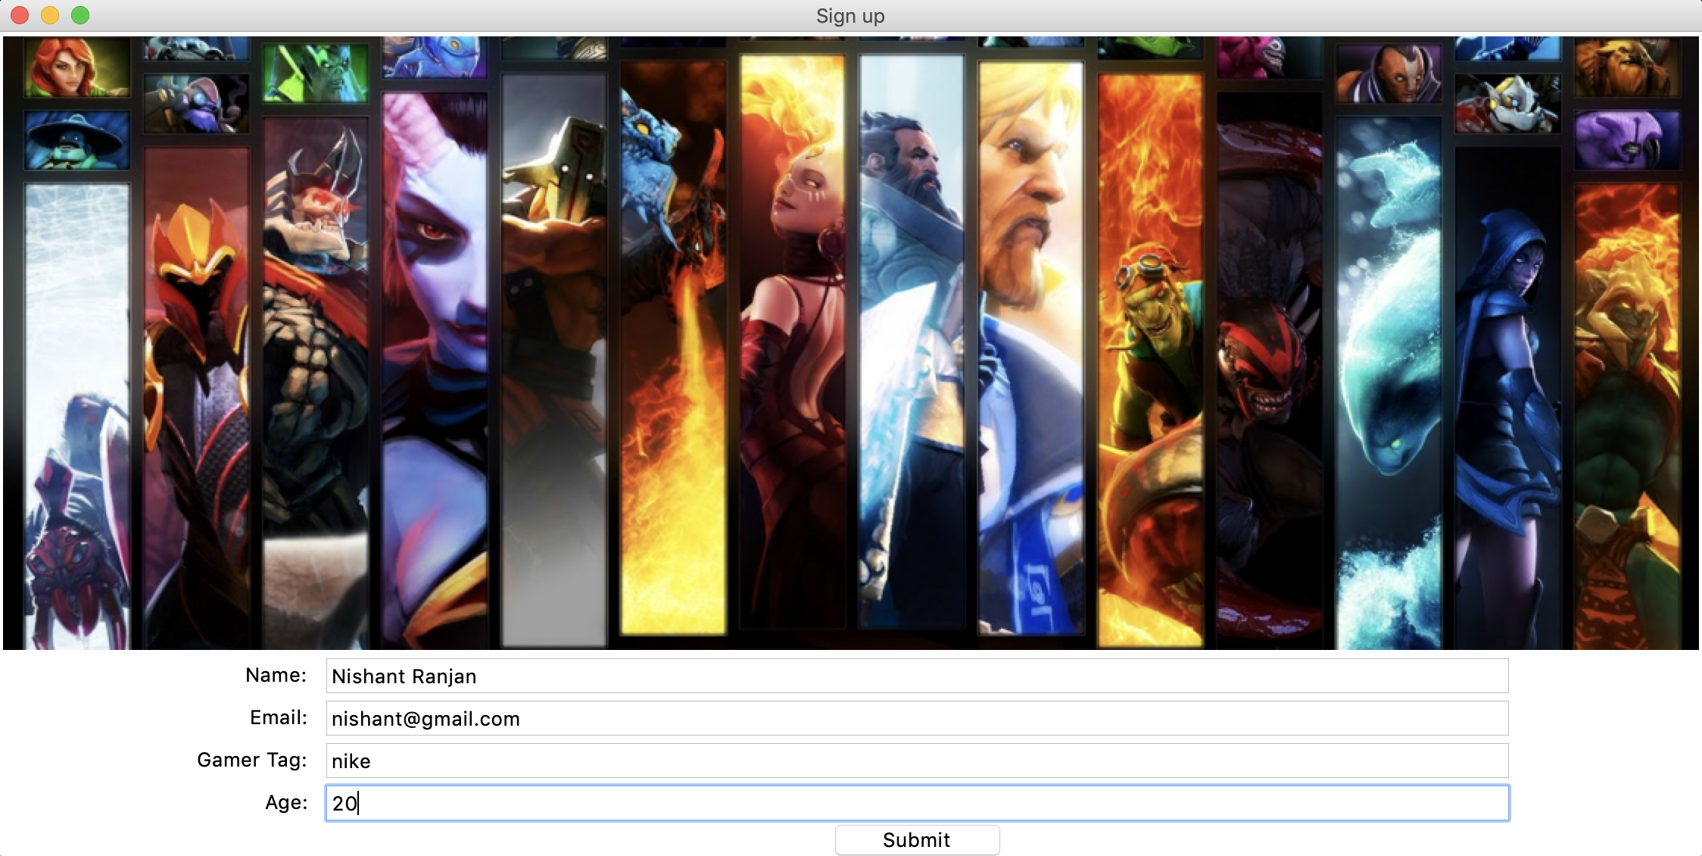
Gamer Signup

Slide 12
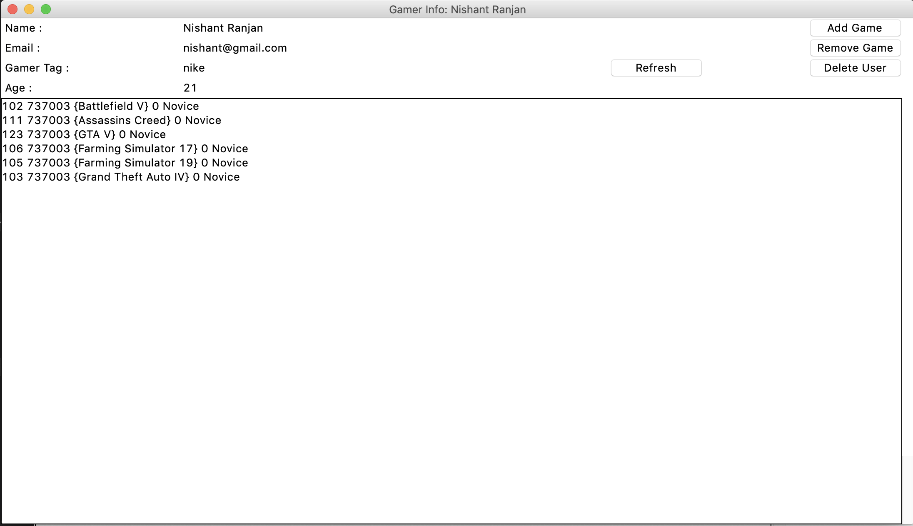
Gamer Details

Slide 13
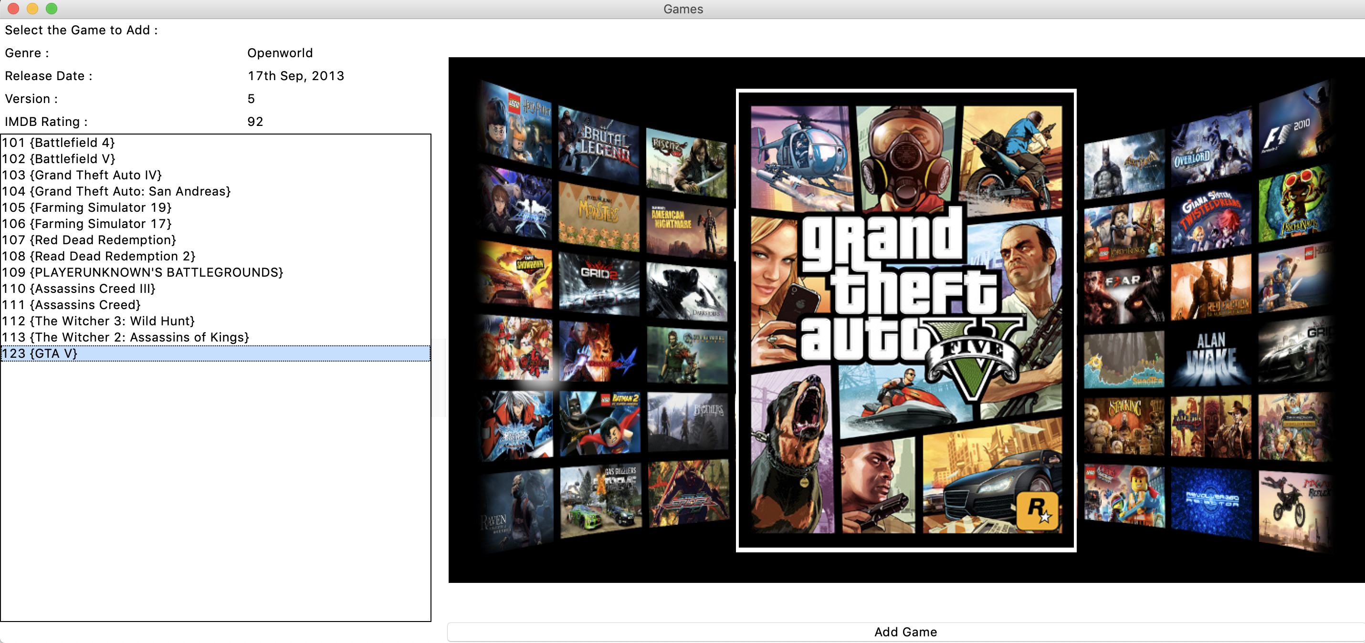
Add game

Slide 14
Future Plans
Implementation with the Networking concepts to integrate over LAN.
Real time data synchronization of gamers.

Slide 15
Thank you
Mohammed Ataaur Rahaman – 1DS16CS721
Nishant Ranjan – 1DS16CS724

